Slide 1
KEY LOGGERS & SECURITY IMPLEMENTATION
CAPSTONE PROJECT
Presented By:
Krishna kumari BE CSE – 3Year SATYAM COLLEGE OF ENGINEERING AND TECHNOLOGY

Slide 2
OUTLINE
Problem Statement
Proposed System/Solution
System Development Approach (Technology Used)
Algorithm & Deployment
Result
Conclusion
Future Scope
References

Slide 3
PROBLEM STATEMENT
Tasked with creating a basic keylogger program in Python. The keylogger should run silently in the background, capturing all keystrokes made by the user and saving them to a log file.

Slide 4
PROPOSED SOLUTION
The proposed system aims to Tasked with creating a basic keylogger program in Python. The keylogger should run silently in the background, capturing all keystrokes made by the user and saving them to a log file.
Install Required Libraries:
Install the ‘pynput’ library, which is used for monitoring keyboard events.
Import Necessary Modules:
Import the required modules in your Python script.
Set Up Logging:
Set up logging to save the keystrokes to a log file.
Define the Keystroke Logging Function:
Define a function to log keystrokes when a key is pressed.
Start the Listener:
Start the listener to monitor keyboard events.
Handle KeyboardInterrupt (Optional):
Optionally, you can handle ‘KeyboardInterrupt’ to gracefully exit the program.
Run the Script:
Save the script in a Python file (e.g., keylogger.py) and run it using Python.
This script will silently run in the background, capturing all keystrokes made by the user and saving them to the specified log file (keylog.txt).

Slide 5
SYSTEM APPROACH
The "System Approach" section outlines the overall strategy and methodology for developing and implementing the keylogger & Security implementation system. Here's a suggested structure for this section:
System requirements(python Idle)
Library required to build the model

Slide 6
ALGORITHM & DEPLOYMENT
Algorithm for Creating a Basic Keylogger Program in Python:
Import necessary libraries:pynput for monitoring keyboard events.
os for handling file operations.Define global variables:log_file: Path to the log file where keystrokes will be saved.
Define callback functions:on_press(key):
This function is called whenever a key is pressed.
It appends the pressed key to the log file.on_release(key):
This function is called whenever a key is released. It checks if the "Escape" key is pressed to stop the listener.Define the main function:start_keylogger():
This function initializes the keylogger by creating a Listener object with the specified callback functions.Optionally, hide the console window:
This step is for stealth purposes and depends on the operating system.Start the keylogger:Call the start_keylogger() function

Slide 7
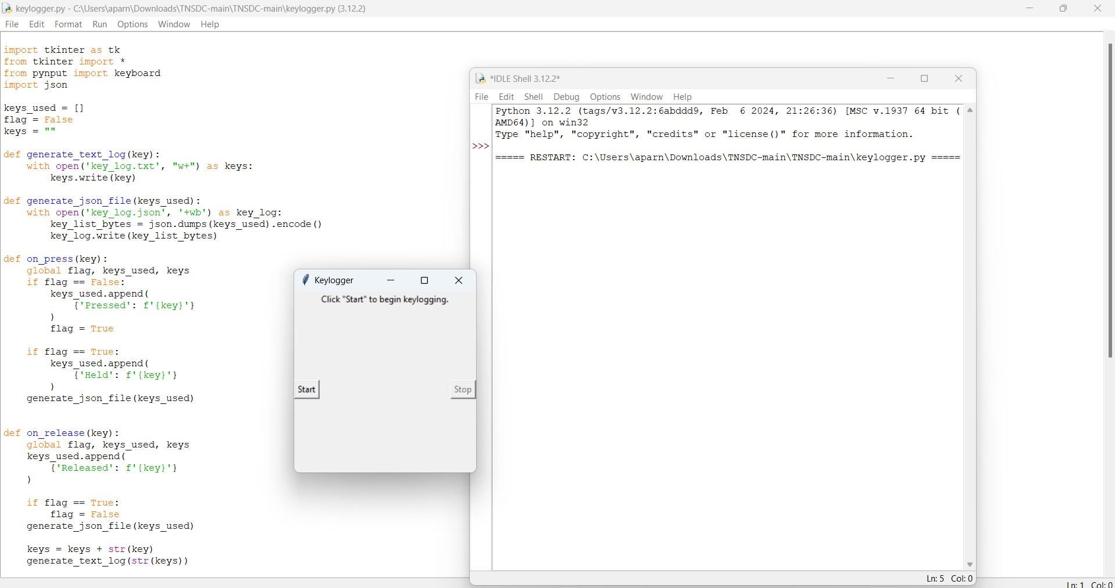

RESULT
.

Slide 8
CONCLUSION
In conclusion, mitigating the threat of keyloggers and enhancing overall security requires a multi-faceted approach that combines advanced algorithms, strategic deployment strategies, and continuous monitoring. By implementing robust endpoint protection solutions, network security measures, and user education programs, organizations can detect and prevent keylogger infections , minimizing the risk of sensitive data theft and unauthorized access. Additionally, regular audits and assessments help ensure that security measures remain effective against evolving threats. Overall, a proactive and comprehensive approach to keylogger and security management is essential to safeguarding sensitive information and maintaining a secure computing environment.

Slide 9
FUTURE SCOPE
The future scope of keylogger and security involves the ongoing development and implementation of
advanced technologies, innovative strategies, and collaborative efforts to address evolving cyber
threats and protect against keylogger attacks.
Advanced detection techniques
Endpoint security innovations
Zero trust architecture
Quantum cryptography
Behavioral biometrics
Blockchain technologies
Collaborative defense mechanisms

Slide 10
REFERENCES
Books:
"The Web Application Hacker's Handbook: Finding and Exploiting Security Flaws" by Dafydd Stuttard and
Marcus Pinto.
"Practical Malware Analysis: The Hands-On Guide to Dissecting Malicious Software" by Michael Sikorski
and Andrew Honig.
Academic Journals and Papers:
IEEE Security & Privacy: A peer-reviewed journal that publishes research articles, case studies, and surveys on
various topics in cybersecurity, including keyloggers and malware.
ACM Digital Library: Offers access to a wide range of academic journals, conference proceedings, and technical
papers in the field of computer science and cybersecurity.

Slide 11
THANK YOU

